Slide 1

Advanced Estate Planning Techniques and the Role of Life Insurance
Jeffrey A. Baskies
Katz Baskies LLC
2255 Glades Road, Suite 240W
Boca Raton, Florida 33431
Telephone: 561-910-5700 www.katzbaskies.com
54363

Slide 2
2012 – A Great Year For Estate Planning or the Greatest Year?
Looking back in 20 or 50 years families may say: “2010-2012 was the peak of estate planning” … “Planning our parents did then, set us up for generations” …
We have:
  A $5 million gift tax exemption
  The lowest AFRs in history
  A gift tax rate of 35%
  The ability to discount assets
  Dynasty trusts without a rule against perpetuities
  Grantor trusts

Slide 3
Change is Coming
On January 1, 2013, the Tax Relief, Unemployment Insurance Authorization, and Job Creation Act of 2010 will expire, resulting in:
  Approx $1 million gift/estate/GST tax exemption; and
  A top gift and estate tax rate of 55%
The Administration’s Revenue Proposals for 2013 include:
  The Elimination of Grantor Trusts for estate planning
  The Elimination of Valuation Discounting for most assets
  A minimum 10-year term for GRATs and a maximum term
  An Expiration Date on GST Exemption – 90 years

Slide 4
Top Ten Planning Ideas for the $5 Million Gift Tax Exemption
Make an Outright Transfer
Make a Transfer to a Trust – consider life insurance
Make the Trust a Grantor Trust
Create and Fund a GRAT
Employ a SLAT/Grantor Trust
Employ two (2) SLATs that are non-reciprocal
Use one or more QPRTs
House Gift/Sale to an Irrevocable Grantor Trust
Create one or more Inter Vivos CLTs
Consider “Exotic” CLTs

Slide 5

1. Outright Transfers
Clients can simply make outright transfers to their children, descendants and/or others beneficiaries to fully use their $5 million exemption

Slide 6
Outright Transfers (cont’d)
Pros:
Straightforward
Least administrative costs
Donees have immediate access to the funds
Freezes the value of the transferred assets
Cons:
Assets transferred are exposed to the donee’s creditors and may be subject to division if donee divorces
Does not leverage the exemption; however, discounted assets may be used

Slide 7
2. Transfer to a Trust for Beneficiaries
Instead of transferring the assets outright, clients can transfer the assets to a trust for the benefit of children, descendants and/or other beneficiaries
John Smith
The trust is held for a class of beneficiaries composed of John’s descendants.
Insurance Idea: The trust could buy life insurance.
Smith Family Trust
$5 Million

Slide 8
Transfer to a Trust for Beneficiaries
Pros:
Offers stronger protection of the transferred assets than outright ownership from any creditors of the donee or in the event the donee divorces
Transferred funds are immediately available to the trust beneficiaries
If GST exemption applied, assets are excluded from donees’ estates
Freezes the value of the transferred assets
Cons:
Higher administrative cost than outright transfer
Does not leverage the exemption amount

Slide 9
3. Make It A Grantor Trust
A trust may be designed as a “grantor trust” for income tax purposes, allowing:
All items of income to be taxed directly to the grantor – permitting the trust assets to grow on a tax free basis and all the tax payments grantor makes further reduce the grantor’s estate – see Rev. Rul. 2004-64
Sales of assets to the trust, loans to the trust and leases of trust property without income tax liability – Rev. Rul. 85-13

Slide 10
Gift Tax Concerns With Sale Transfers to Grantor Trusts
When assets are sold to a grantor trust, it is a non-event for income tax purposes. However, there may be a gift tax if the IRS later determines that the consideration received from the trust was not equal to the FMV of the assets sold
One solution to this problem has been the use of formula clauses that provide any excess is transferred to a charity
The IRS has argued these formulae are void for public policy reasons

Slide 11
Putting a Lid on Gift Tax Concerns
Some courts were persuaded by the IRS’s position that these formulae violated public policy, as it removes the IRS’s incentive to challenge the transfer – Comm’r v. Procter, 142 F.2d. 824 (4th Cir. 1944)
Then came Petter v. Comm’r, 653 F.3d 1012 (9th Cir. 2011) and Hendrix v. Comm’r, T.C. Memo 2011-133, approving formula clauses
The clauses at issue in Petter and Hendrix called for any excess to pass to a community foundation and each foundation participated in the transaction and received funds from the outset
A recent tax court case approving a formula transfer did not involve a charity - Wandry v. Comm’r, T.C. Memo 2012-88

Slide 12
4. Grantor Retained Annuity Trust with a Taxable Remainder
John Smith
Age: 60
Assuming 5% growth, the amount remaining at the end of the annuity term – the amount passing to or for the benefit of John’s children and descendants is approximately $12.8 million. These results can be further enhanced with discountable assets
John transfers $10 million in cash and marketable securities to a GRAT in April 2012 (7520 rate is 1.4%) and receives a 15 year annuity interest of $370,000 in return – taxable gift of approximately $5 million
$10 Million cash and marketable securities
15 year annuity
John Smith GRAT

Slide 13
Zeroed-Out GRATs
The annuity payments and term can be varied to achieve a GRAT that results in no gift tax upon funding – a “zeroed-out” GRAT.
John Smith
Age: 60
Assuming 5% growth, the amount passing to or for the benefit of John’s children and descendants is approximately $4.8 million
John transfers $10 million in cash and marketable securities to a GRAT in April 2012 (7520 rate is 1.4%) and receives a 15 year annuity interest of approximately $744,000 in return – *NO* taxable gift
$10 Million cash and marketable securities
15 year annuity
John Smith GRAT

Slide 14
Short Term GRATs
Financial modeling shows that GRATs work better when the transferred assets have a strong return in the first year or two. One approach to help ensure a successful GRAT is to use multiple 2 year zeroed-out GRATs, with different asset classes and a 99% payout in year one with the rest paid in year two
If a GRAT fails to outperform the 7520 rate, then you just get your money back and can try again
Decreasing GRATs may be eliminated in 2013

Slide 15
GRAT - Taxable Remainder (cont’d)
Pros:
GRATs are sanctioned under the Code and Regs
GRATs can leverage exemption
Freezes the value of the transferred assets
Can increase annuity payments by 20%/year – or decrease
Cons:
Assets are not immediately available to the donee
No GST leverage due to ETIP period - GST tax exemption cannot be allocated until the GRAT term ends
Client loses access to (and control over) the funds transferred
The trust assets are includible in client’s estate if client dies during the annuity term

Slide 16
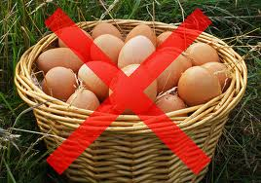
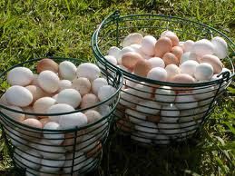
Multiple GRATs
For clients considering GRATS, they may wish to consider creating multiple GRATs with different annuity terms and/or different asset allocations – possibly increasing the chance of their success. Although, for longer term GRATs, this may not work.

Slide 17
Insurance for GRATs
The grantor’s death during the term of a GRAT will generally result in the inclusion of all of the GRAT assets in the grantor's estate for estate tax purposes
An Insurance policy can be purchased to hedge against this risk
  Term equal to the GRAT annuity term;
  Benefit equal to the estimated additional estate tax resulting from the inclusion

Slide 18
5. Spousal Lifetime Access Trust/Inter Vivos Credit Shelter Trust
Client could transfer assets to an inter vivos trust for the benefit of client’s spouse and/or others
John Smith
The Family Trust is held for a class of beneficiaries composed of John’s spouse and John’s descendants. John’s wife can use any assets distributed to her for the benefit of herself or John
$5 Million
Smith Family Trust

Slide 19
Spousal Lifetime Access Trust/Inter Vivos Credit Shelter Trust (cont’d)
Pros:
Helps to enable the client to have access to the transferred funds if needed - either through client’s spouse or through a trust created by client’s spouse
Trust(s) can be made GST exempt
Excluded from beneficiaries’ estates
Provides a level of asset protection to the funds in the trust
Cons:
Does not offer a tremendous amount of leverage; however, discounted assets may be used
Administrative costs
Gift splitting may not be permitted if spouse is a beneficiary

Slide 20
Insurance Idea for a SLAT
Because the client’s spouse loses the funds on spouse’s death, it could make sense to buy insurance on the spouse’s life in an ILIT

Slide 21
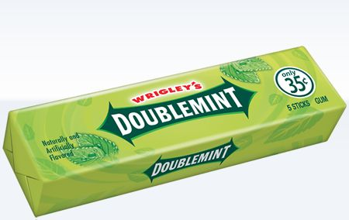
6. Two SLATs
The client and the client’s spouse could each transfer assets to an inter vivos trust for the benefit of the other spouse and the descendants
John Smith
Susan
Smith
$5 Million cash and marketable securities
$5 Million cash and marketable securities
Smith Family Trust I
Smith Family Trust II
The terms of Smith Trust I and Smith Trust II must be different from one another to avoid any reciprocal trust problems, and preferably are not created at the same time and pursuant to the same prearranged plan. Consider using a DAPT jurisdiction, e.g., NV or AK

Slide 22
SLATs as Self-Settled Asset protection Trusts?
Can the donor give the donor’s spouse a limited power of appointment over the trust that can be exercised in favor of the donor and then have the donor’s spouse exercise this power in favor of the donor to create a trust for the donor upon donor’s spouse’s death (or during life)?
John Smith
Trust A
Trust B
Fund Trust A for the benefit of John’s spouse (Susan) and descendants
Susan is given the power to appoint assets to a trust for John
Susan appoints assets to Trust B for the benefit of John and descendants

Slide 23
SLATs as Self-Settled Asset protection Trusts (Cont’d)
Giving Susan the power of appointment is likely acceptable, but if Susan exercises it, then the assets are likely includible in John’s estate when he dies
F.S. §736.0505(2)(3) was added to provide spendthrift protection with respect to a trust created for the benefit of the original donor upon the termination of an inter vivos QTIP trust. This protection is not available if the intervening trust is not a QTIP trust –leading to estate tax inclusion under IRC § 2042
Also, there is the possibility for inclusion under IRC §2036. Treas. Reg. §20.2036-1(c)(1)(i) – “An interest or right is treated as having been retained or reserved if at the time of the transfer there was an understanding, express or implied, that the interest or right would later be conferred.”

Slide 24


7. Qualified Personal Residence Trusts
Client transfers his or her primary or secondary residence to a QPRT (or transfers fractional interests in the residences to multiple QPRTs)

Slide 25
QPRTs (cont’d)
Pros:
QPRTs are specifically authorized under the Code and Treasury Regulations
Retain SOH benefits during QPRT term
Freezes the value of the transferred residence – and potential discounts for fractional gifts to multiple QPRTs
Cons:
The expiration of the QPRT term may trigger a SOH reassessment unless client enters a 99-year lease
GST cannot be allocated until QPRT/ETIP term expires
Complications arise when property is subject to a mortgage – documentary stamp taxes and future principal payments may be treated as gifts
Client cannot reacquire the residence and must survive term to avoid estate inclusion

Slide 26
Insurance for QPRTs
As with a GRAT, if client fails to survive the QPRT term, the asset is included in the client’s estate for estate tax purposes
An insurance policy can be acquired to hedge against the inclusion risk associated with a QPRT
  Benefit equal to the projected estate tax exposure resulting from inclusion of the residence (taking into account appreciation)
  Term equal to the QPRT term

Slide 27
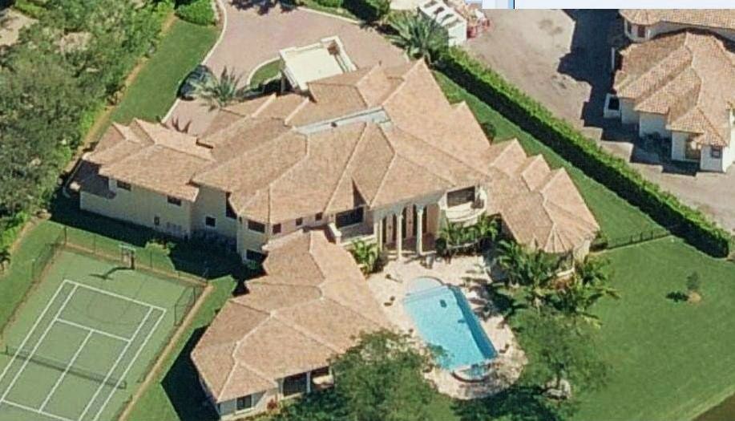

8. Gift/Sell Residence to a Grantor Trust
Instead of a QPRT, the residence could be gifted and/or sold to an irrevocable trust without any retained interest. Client could then lease the property for fair rental value

Slide 28
Benefits of Gifting/Selling Residence to a Grantor Trust
Lease payments further reduce the client’s estate
Client can reacquire the residence for its full fair market value with assets having a higher tax basis – benefiting the remainder beneficiaries and terminating the lease payments if necessary
GST tax exemption can be freely allocated to the trust
Even if the taxpayer does not survive the note term, the residence will not be included in the taxpayer’s estate (unlike when the taxpayer dies during the QPRT term)
If property is sold to the trust for a Note, the AFR rates are used instead of the Section 7520 Rate
No limit on the number or types of residences one can sell
Property does not have to be a residence

Slide 29
Drawbacks of Gifting/Selling Residence to a Grantor Trust
Selling a residence to a grantor trust is not specifically sanctioned under the Code or Treasury Regulations
Potential unwanted gift tax exposure if the residence is revalued. Defined value formula clauses may help to minimize this exposure if respected. See McCord v. Comm’r., 461 F.3d 614 (5th Cir. 2006), rev’g, 120 T.C. 358 (2003); Christiansen v. Comm’r., 104 AFTR 2d 2009-7352 (8th Cir. 2009), rev’g 130 T.C. 1 (2008); Petter v. Comm’r., T.C. Memo. 2009-280; and Hendrix v. Comm’r, T.C. Memo 2011-133

Slide 30
Drawbacks of Gifting/Selling Residence to a Grantor Trust (cont’d)
The Grantor Trust will have a basis in the asset equal to the grantor's basis at the time of the transfer
Possible stamp taxes owing – if the property is sold to the trust then on the consideration received, or if the property is encumbered then on the amount of debt outstanding
May trigger a SOH reassessment of the property

Slide 31
Insurance Idea When Selling Residence to a Grantor Trust
If the client sells his or her residence to a Grantor Trust in exchange for a promissory note, the note will be included in the client’s estate if he or she dies while the note is outstanding
Possible Solution – Use the rent payments to buy life insurance in the Grantor Trust to offset the amount of estate tax to be incurred if the note is included in the client’s estate

Slide 32
Insurance for IDGTs
Whenever assets are discounted in connection with a transfer, there is the risk that the IRS will successfully challenge the discount, resulting in an increase gift tax owing
Taxpayer could acquire a life insurance policy to hedge against this risk
  Term should be equal to the statute of limitations (3-6 years from the date the gift tax return is filed)
  Benefit should equal potential gift tax exposure

Slide 33
9. Charitable Lead Trust with a Taxable Remainder
The structure of the trust is effectively the same as with the GRAT except the annuitant during the initial term is a charitable organization – possibly a private foundation (wall off client) or a DAF at your local community foundation
15 year annuity
Donor Advised Fund at Community Foundation
John Smith
Age: 60
John Smith CLAT
$10 million in cash and marketable securities
Trusts for Bene-ficiaries
Remainder
John transfers $10 million to a CLAT in April 2012 using the (7520 rate for April-1.4%) and creates a 15 year annuity interest of $370,000 – charitable gift is approximately $5 million
Assuming 5% growth, the amount remaining at the end of the annuity term – the amount passing to or for the benefit of John’s children and descendants is approximately $12.8 million. These results can be further enhanced with discountable assets

Slide 34

Charitable Lead Trust with a Taxable Remainder (cont’d)
Pros:
CLATs are sanctioned under the Code
Allows leverage of the exemption
Freezes the value of the transferred assets
Can increase annuity payments by 20%/year (or more?)
Cons:
Assets are not immediately available to the donee
GST tax exemption cannot be allocated until the charitable term ends
Client loses access to (and control over)
the funds transferred

Slide 35

A CLAT with an ILIT on the Side
The client can employ an ILIT at the time the client established
This allows the client to set a floor as to how much the remainder beneficiaries will receive at the end of the charitable term – in case the assets don’t outperform the 7520 rate
GST tax exemption can be allocated to the ILIT currently
Assets in the ILIT would be available to the beneficiaries immediately

Slide 36
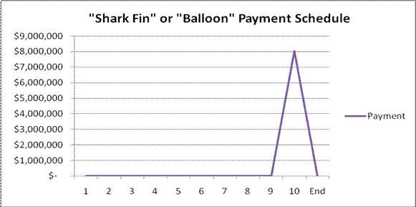
10. “Exotic” CLTs
Shark-Fin and Other Increasing CLATs

Slide 37
Shark-Fin and Other Increasing CLATs (cont’d)
All rates of return are not equal
The rate of return path can have a great impact on the viability of a CLAT
For example, 2 CLATs with 8% average annualized returns may have vastly different results for the remainder beneficiaries
High returns in early years strongly benefit the overall performance of a CLAT (or GRAT)

Slide 38
Shark-Fin CLAT with Insurance
A Shark-Fin CLAT could be funded with an insurance policy
If the CLAT owns a life insurance policy and pays the premiums, its possible that the charitable income tax deduction for the amounts transferred to the CLAT would be disallowed under the “charitable split-dollar” rules of §170(f)(10)
In order to avoid the split-dollar rules under §170(f)(10)(A)(ii) of the Code, it is recommended that the client contribute a fully paid up policy to the CLAT

Slide 39
Investment Returns
 | Average Return | Return 1 | Return 2
Year 1 | 9.3 | 10.1 | -22.1
Year 2 | 9.3 | 1.3 | -11.9
Year 3 | 9.3 | 37.6 | -9.1
Year 4 | 9.3 | 23 | 21
Year 5 | 9.3 | 33.4 | 28.6
Year 6 | 9.3 | 28.6 | 33.4
Year 7 | 9.3 | 21 | 23
Year 8 | 9.3 | -9.1 | 37.6
Year 9 | 9.3 | -11.9 | 1.3
Year 10 | 9.3 | -22.1 | 10.1
Average | 9.3% | 9.3% | 9.3%
 | Small remainder | S & P 93-02 Larger remainder | Reverse Failure
Source: Paul Lee – Bernstein

Slide 40
Shark-Fin and Other Increasing CLATs (cont’d)
Shark-fin or increasing payout CLATs mitigate against the impact of return path, by reducing principal encroachment (particularly in the early years)
This leaves more money in the trust to work for the client, and increases the likelihood of overcoming any years with bad returns

Slide 41

Multiple CLATs
As with GRATs, one may consider employing multiple CLATs with different charitable terms and asset classes
However, given the longer term of CLATs, the segregation of asset classes may not work as well (if at all) for CLATs
53928

Slide 42
Insurance for Lifetime CLATs
The grantor’s death during the term of a CLAT will generally result in the inclusion of all of the CLAT assets in the grantor's estate for estate tax purposes
An Insurance policy can be purchased to hedge against this risk
  Term equal to the CLAT annuity term;
  Benefit equal to the estimated additional estate tax resulting from the inclusion

Slide 43
Testamentary CLATs (TCLATs)
Sometimes lifetime planning cannot avoid an estate tax. Enter the TCLAT
A TCLAT functions just like a lifetime CLAT, except it funded upon death
  Usually funded upon the second death
  Funded with an amount equal to the amount of the client’s taxable estate in excess of the client’s remaining estate tax exemption
  Often structured as a zeroed-out CLAT

Slide 44
TCLATs (Cont’d)
There are two significant limitations with TCLATs:
  It is impossible to predict what the 7520 rate will be at upon the client’s death. Remember, for there to be assets remaining at the end of the charitable term, the assets in the CLAT must outperform the 7520 rate then in effect
  The client’s descendants (or other remainder beneficiaries) do not have access to the funds during the CLAT term

Slide 45
Insurance for TCLATs
Client could purchase life insurance in an Irrevocable Life Insurance Trust (“ILIT”) to ensure that the client’s remainder beneficiaries have access to sufficient assets to until the charitable term of the TCLAT terminates
The client could purchase an insurance policy in an ILIT with a benefit equal to the potential estate tax exposure without employing a TCLAT
The client could purchase an insurance policy with a benefit equal to the amount going to the TCLAT – to ensure the remainder beneficiaries receive a certain amount

Slide 46
Insurance for TCLATs (Cont’d)
While having an insurance policy in an ILIT can replace any wealth lost as a result of the estate tax, the use of an insurance policy in conjunction with a TCLAT can reduce the size of the insurance policy that must be purchased – making it more affordable – and potentially pass more assets on to the client’s ultimate beneficiaries.

